Slide 1
DPCM (DIFFERENTIAL PCM)
Reason to use DPCM
The samples of a signal are highly correlated with each other. This is due to the fact that any signal does not change fast. Which means , its value from present sample to next sample does not vary by a large amount.
The adjacent samples of the signal carry the same information with a little difference.
When these samples are encoded by a standard PCM system, the resulting encoded signal contains some redundant information.

Slide 2
To process this redundant information and to have a better output, it is a wise decision to take a predicted sampled value, assumed from its previous output and summarize them with the quantized values. Such a process is called as Differential PCM.

Slide 3
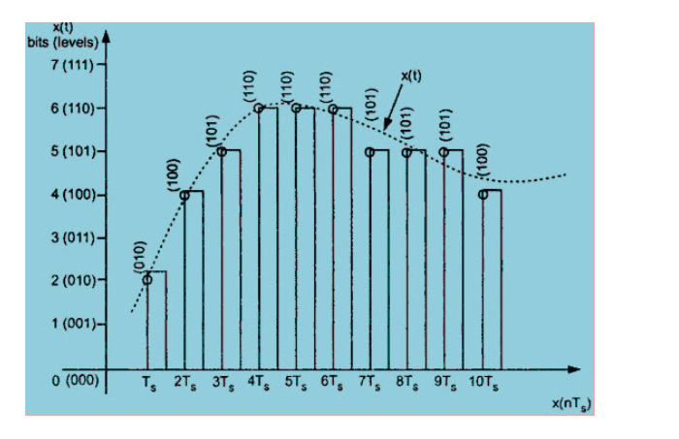
Fig: Illustration of redundant information in PCM

Slide 4
Redundant information in PCM
Fig. shows a continuous time signal x(t) by dotted line. This signal is sampled by flat top sampling at intervals T_{s} , 2T_{s} , 3T_{s} ….. nT_{s} .
The sampling frequency is selected to be higher than nyquist rate.
The samples are encoded by using 3 bit (7 levels) PCM.
The sample is quantized to the nearest digital level as shown by small circles in fig.1 .
The encoded binary value of each sample is written on the top of the samples.

Slide 5
We can observe from fig. that the samples taken at 4T_{s} , 5T_{s} and 6T_{s} are encoded to same value of (110).
This information can be carried only by one sample.
But 3 samples are carrying the same information means that it is redundant .
Samples taken at 9T_{s} and 10T_{s}. The diff btw these samples only due to last bit and first two bits are redundant, as they do not change.
If this redundancy is reduced, then overall bit rate will decrease and no. of bits required to transmit one sample will also be reduced.
This type of digital pulse modn technique is called as DPCM.

Slide 6
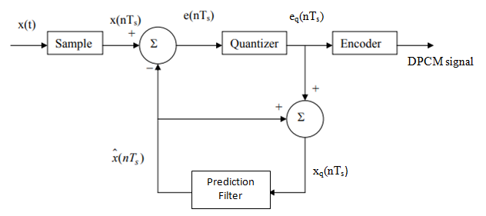
Working Principle
The differential pulse code modulation works on the principle of prediction. The value of the present sample is predicted from the past samples.
The prediction may not be exact but it is very close to the actual sample value.
Fig. shows the transmitter of DPCM system.

Slide 7
The sampled signal is denoted by x(nT_{s}) and predicted signal is denoted by xˆ(nT_{s}).
The comparator finds out the difference between the actual sample value x(nT_{s}) and predicted sample value xˆ(nT_{s}).
This is known as prediction error and it is denoted by e(nT_{s}).
It can be defined as ,
e(nT_{s}) = x(nT_{s}) – xˆ(nT_{s})……………………….(1)
The predicted value is produced by using a prediction filter.
The quantizer output signal e_{q}(nT_{s}) and previous prediction is added and given as input to the prediction filter. This signal is called x_{q}(nT_{s}).

Slide 8
This makes the prediction more and more close to the actual sampled signal.
We can observe that the quantized error signal e_{q}(nT_{s}) is very small and can be encoded by using small number of bits.
Thus no. of bits per sample are reduced in DPCM.
The quantizer output can be written as ,
e_{q}(nT_{s}) = e(nT_{s}) + q(nT_{s})………………………..(2)
Here, q(nT_{s}) is the quantization error.
The prediction filter input x_{q}(nT_{s}) is obtained by sum xˆ(nT_{s}) and quantizer output. i.e.,
x_{q}(nT_{s}) = xˆ(nT_{s}) + e_{q}(nT_{s})……………………..(3)

Slide 9
Substituting the value of e_{q}(nT_{s}) from eq.(2) in the above eq. (3) , we get,
x_{q}(nT_{s}) = xˆ(nT_{s}) + e(nT_{s}) + q(nT_{s}) ………………….(4)
eq.(1) is written as,
e(nT_{s}) = x(nT_{s}) – xˆ(nT_{s})
e(nT_{s}) + xˆ(nT_{s}) = x(nT_{s})
Therefore, substituting the value of e(nT_{s}) + xˆ(nT_{s}) from the above equation into eq. (4), we get,
x_{q}(nT_{s}) = x(nT_{s}) + q(nT_{s}) …………………..(5)

Slide 10
Hence the quantized version of s/g x_{q}(nT_{s}) is the sum of the original sample value & quantization error q(nT_{s}).
Quantization error can be +ve or –ve.
Thus eqn (5) doesnot depend on the prediction filter characteristics.

Slide 11
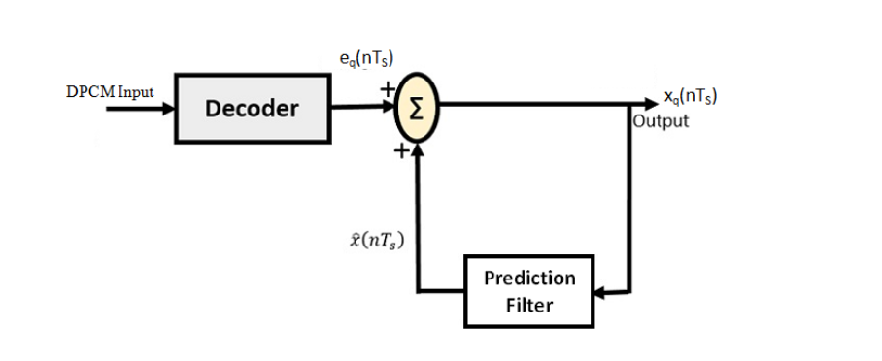
Reception of DPCM Signal
DPCM RECEIVER

Slide 12
The decoder first reconstructs the quantized error signal from incoming binary signal.
The prediction filter output and quantized error signals are summed up to give the quantized version of the original signal.
Thus the signal at the receiver differs from actual signal by quantization error q(nT_{s}), which is introduced permanently in the reconstructed signal.
Types of predictors used for DPCM:
One-tap predictors
N-tap predictors

Slide 13
Advantages of DPCM
As the difference between x(nT_{s}) and xˆ(nT_{s}) is being encoded and transmitted by the DPCM technique, a small difference voltage is to be quantized and encoded.
This will require less number of quantization levels and hence less number of bits to represent them.
Thus signaling rate and bandwidth of a DPCM system will be less than that of PCM.

Slide 14
LINEAR PREDICTION
In linear prediction, the future values of a discrete time signals are estimated as a linear function of previous samples.
It is a method used to reduce the BW required to transmit PCM pulses.
It is widely used in speech communications over mobile channels, channel prediction, stock market prediction & many other applications.

Slide 15
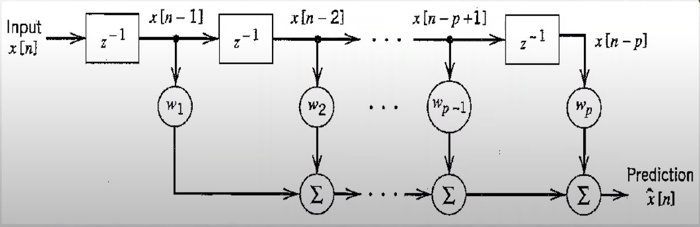
LINEAR PREDICTION FILTER

Slide 16
Tapped delay line filter used as prediction filter
Future samples $\hat{x}[$n] of a discrete s/g can be predicted from the present samples of the discrete signals by passing x[n] into linear prediction filter shown above.
Block containing z⁻¹ is the delay element.
w is the weights which defines the response of your filter.
When s/g passes thru frst delay element, we get x[n-1]
Similarly passing thru p^{th} delay element -----x[n-p]

Slide 17
The equation that describes the process is given by (convolution)
$\hat{x}[$n] = $\sum_{k=1}^{p}{\text{w}\text{k}}x[n−k]$
Where p is the no. of unit delay elements which is called the prediction order.
w represents weights of the taps.

Slide 18
Design of Linear predictor
Prediction error e[n] = x[n] - $\hat{x}[$n]
How many filter taps are required?
The design objective is to choose the filter coefficients w_{1, …..,} w_{p} so as to minimize the mean square error
J = E[e²[n]]
Substitute value of e[n] in this eqn, we get
J = E[ x²[n] -2x[n] $\hat{x}[$n]+ ($\hat{x}[$n])²]

Slide 19
J = E[ x²[n]] -2 $\sum_{k=1}^{p}{\text{w}\text{k}} E[x[n−k]$ x[n]] + $\sum_{j=1}^{p}{\sum_{k=1}^{p}{\text{w}j}\text{w}\text{k}}E[x[n−j]$ $x[n−k]$ ]
If the i/p s/g x(t) is a sample function of a stationary process X(t) of zero mean ie. E[x[n]]=0, then
$σ$_{x}² = E[ x²[n]] – (E[x[n]])²
$σ$_{x}² = E[ x²[n]]
The term E[x[n]x[n-k]]=R_{x}[k] is the autocorrelation function of x[n].
The mean square error J can be rewritten as

Slide 20
J = $σ$_{x}² - 2 $\sum_{k=1}^{p}{\text{w}\text{k}} \text{R}\text{x}\text{[}\text{k}\text{]}$ + $\sum_{j=1}^{p}{\sum_{k=1}^{p}{\text{w}j}\text{w}\text{k}}\text{R}\text{x}\text{[}\text{k}\text{−}\text{j}\text{]}$
Inorder to find the coefficients which minimize the error, we differentiate J wrto w_{k} and equate with 0.
$$\frac{∂J}{∂w_{k}}=0$$

Slide 21
WIENER – HOPF EQUATION
$$\frac{∂J}{∂w_{k}}=0$$
If we apply the derivative to the mean square error J , we get the following eqn.
$\sum_{j=1}^{p}{\text{w}\text{j} }\text{R}\text{x}\text{[}\text{k}\text{−}\text{j}\text{]}$ = $\text{R}\text{x}\text{[}\text{k}\text{]}$ = R_{x}[-k]
The above optimality equation is called the Wiener – Hopf eqn for linear prediction.
It is convenient to reformulate the Wiener- Hopf eqns in matrix form as follows:

Slide 22
R_{x} w_{o} = r_{x}
w_{o} = [w_{1,} w₂, …, w_{p}]^{T}
Where w_{o} is p-by-1 optimum coefficient vector.
r_{x} is p-by-1 autocorrelation vector.
r_{x} = [R_{x}[1], R_{x}[2], … , R_{x}[p]]^{T}
R_{x} is a p-by-p autocorrelation matrix.

Slide 23
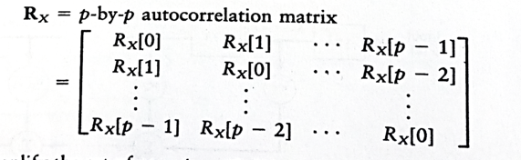

Slide 24
Wiener-Hopf eqn & LP filter design
Inorder to design the linear prediction (LP) filter, we need to compute the tap weights which can be determined from w_{o} = R_{x}⁻¹ r_{x}
The minimum mean square value of the prediction error is obtained by substituting the values w_{o} into J which gives the following eqn.
J _{min} = $σ$_{x}² – r_{x}^{T} R_{x}⁻¹ r_{x}

Slide 25
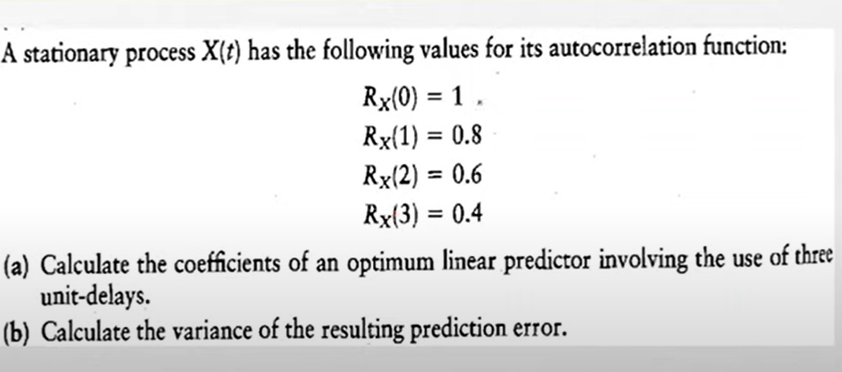
NUMERICAL PROBLEM

Slide 26
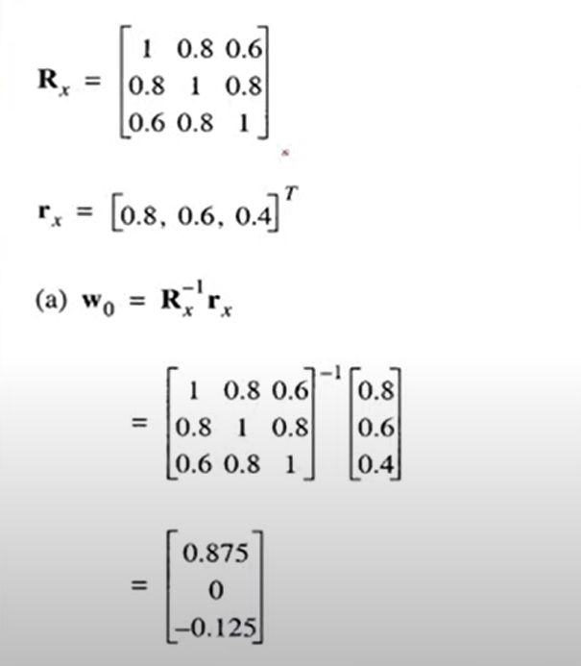
SOLUTION

Slide 27
